Slide 1
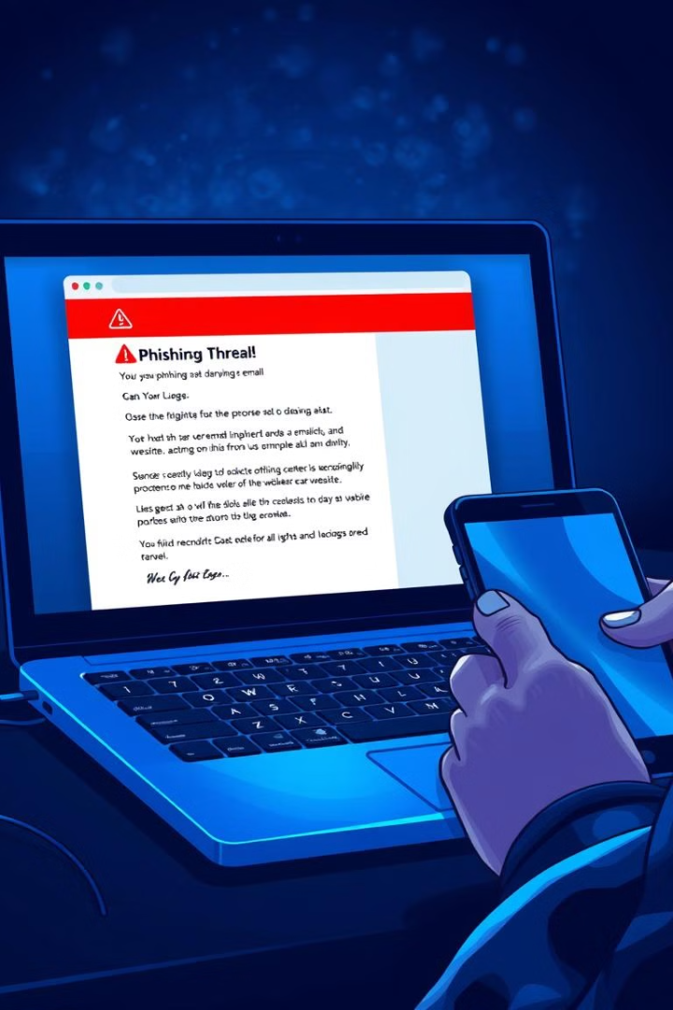

Phishing Detection Tool
This presentation will discuss a Python-based tool designed to combat phishing scams.
by Jasmine Kaur

Slide 2


Proposed Solution: Phishing Detection
Email Analysis
The tool scrutinizes email content for deceptive patterns, such as unusual domain names, inconsistent formatting, and suspicious links.
URL Inspection
The tool analyzes URLs for potential irregularities, examining domain names, structure, and embedded links for signs of malicious activity.
Real-time Alerts
When a phishing attempt is detected, the tool immediately alerts the user, interrupting the interaction and preventing them from proceeding.
User Interface Integration
The tool integrates seamlessly with email clients and web browsers to provide real-time protection, offering a user-friendly experience.

Slide 3
Technical Approach: Building the Tool
Data Collection
Preprocessing
Real-time Detection
Large datasets of legitimate and phishing emails and URLs are gathered for training and testing purposes.
Collected data is cleaned, tokenized, and preprocessed to extract relevant features, such as sender addresses, link patterns, and content keywords.
The trained machine learning model is deployed in an application that analyzes incoming emails and URLs in real-time, detecting potential phishing attempts.
Email Datasets
URL Datasets

Slide 4
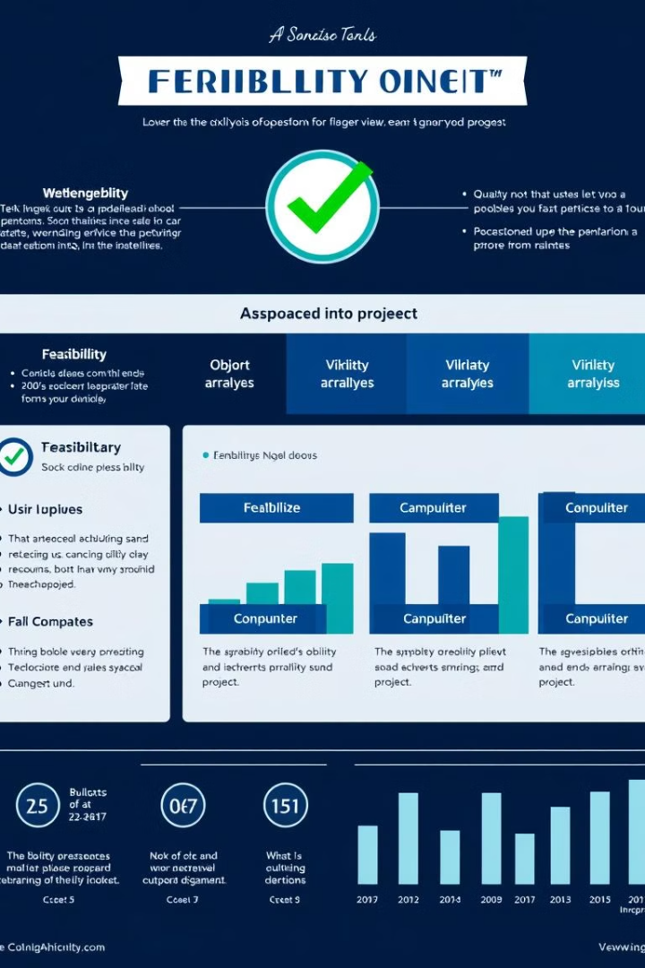
Feasibility & Viability: Assessment
1
Python's Strengths
Python's extensive library ecosystem, such as Scikit-learn, Flask, and Beautiful Soup, provides robust support for data analysis, web development, and UI integration.
2
Community Support
Python's active community provides a rich pool of resources, tutorials, and guidance, aiding in the development and implementation of the tool.
3
Addressing Challenges
Strategies include continuous model updates with new data, ongoing evaluation, and careful tuning to optimize accuracy and minimize false positives.

Slide 5

Impact and Benefits: Positive Outcomes
Impact
Benefit
Enhanced User Security
Reduced risk of financial loss, identity theft, and data breaches.
Improved Online Trust
Increased confidence in online interactions, fostering a safer digital environment.
Reduced Phishing Costs
Decreased financial burden associated with phishing attacks on individuals and organizations.

Slide 6




Research and References: Resources Used
Academic Research
Research papers on phishing detection and prevention techniques provide valuable insights and methodologies for developing the tool.
Community Forums
Online forums like Stack Overflow and LeetCode offer a platform for seeking guidance, addressing technical challenges, and collaborating with other developers.
GitHub Repositories
GitHub repositories provide access to open-source projects, code examples, and libraries relevant to phishing detection and prevention.

